Slide 1


Mandatory CPD Scheme for registered OT
21 May 2026
Education Committee
Occupational Therapists Board

Slide 2
Today’s Objective
Gather Feedback from OT Registrants
Seek input and opinions from OT registrants regarding their perspectives on the proposal for implementing a mandatory Continuing Professional Development (CPD) scheme to ensure that it is practical, subject to approval of OT Board and Allied Health Professions Council.

Slide 3
House Rules
Prohibition of Recording and Filming:
Participants are strictly prohibited from recording the seminar in any form, including but not limited to screenshots, video recordings, or audio captures.
Question Submission:
Participants attending the seminar via Zoom Webinar are required to submit their questions exclusively through the Q&A Box. Any inquiries made through alternative means will not be acknowledged.

Slide 4
Common Questions in mind
Why do I need to have CPD as an OT?
How many CPD points do I need to have, and by when?
How can I obtain CPD points?
Can I be exempted from the mandatory CPD scheme?
How can I track the progress and report my CPD points?
What will happen if I cannot fulfill CPD points by the end of practising certificate renewal?
4

Slide 5
Q. Why do I need CPD as an OT?
Policy Intent
Through CPD, OT registrants will be able to keep pace with rapid advances in OT profession in terms of knowledge, skills and practical experience for the provision of professional service.
Direction of Allied Health Professions Council
  The Council accepted the recommendation of Report of Strategic Review on Healthcare Manpower Planning and Professional Development of 2017, and instructed all Boards to work out its implementation proposal of CPD.
  OP Board, PT Board, OT Board and RG Board have implemented mandatory CPD.
  MLT Board has been working on the details of turning the voluntary CPD to mandatory in the past few years.
Legal Requirement
The legislative amendments to the Allied Health Professions Ordinance, Cap. 359 has stipulated that the Board must not issue a practising certificate to the person unless the board is satisfied that the person has complied with the requirement regarding CPD determined by the Council as applicable to the person. (s.16 of Cap. 359)
5

Slide 6
CPD Assessment Cycle and Points Requirement
The validity period of the practicing certificate has been changed from one year (HK$435) to three years (HK$540) under the Amendment Bills of Supplementary Medical Professions Ordinance, which was passed in July 2025.
A CPD cycle spans three calendar years. The mandatory CPD scheme will run on a three-year cycle, commencing on 1 July of the first year and ending on 30 June of the fourth year. All registered OT, regardless of their registration status (i.e., which part of the Register they are listed in) or whether they reside in Hong Kong or overseas, are required to attain 45 CPD points within each three-year cycle.

Slide 7
CPD point requirements in 3-year cycle
Q. How many CPD points do I need to have, and by when?
Group | End Date of Practising Certificate | Start Date of Practising Certificate | CPD Points required by end date of Practising Certificate | Approximate Duration for obtaining CPD points
A | 30.6.2028 | Between 25.7.2025 and 30.6.2026 | 30 Points | 2 Years
B1 | 30.6.2029 | Between 1.7.2026 and 31.12.2026 | 45 Points | > 2.5 Years
B2 | 30.6.2029 | Between 1.1.2027 and 30.6.2027 | 30 Points | 2.0 – 2.5 Years
C1 | 30.6.2030 | Between 1.7.2027 and 31.12.2027 | 45 Points | > 2.5 Years
C2 | 30.6.2030 | Between 1.1.2028 and 30.6.2028 | 30 Points | 2.0 – 2.5 Years

Slide 8
Q. How could I obtain CPD points?
Categories of CPD Activities
Award Bearing Courses | 2. Accredited Programs
3. Publications | 4. Participation in Study Group (Max 15 points per cycle)
5. Self-Study (Max 15 points per cycle) | 6. Educational Activities (Max 9 points per cycle)

Slide 9
Scope of CPD Activities & Allocation of Points
 | Categories of CPD activities | Credit points for each activity
1. | Award Bearing Courses | Equals to the number of contact hours^
2. | Accredited Programs *
 | Being speaker, either lecturing or presenting at OT or BP relevant accredited programs * Maximum of 24 CPD credit points for a whole day program lasting for six hours or more Maximum of 72 CPD credit points for a single program lasting for three days or more | Equals to the number of hours^ spent in lecturing or presenting multiplied by 4
 | Being audience participant
 | (1) OT relevant | Equals to the number of contact hours^
 | (2) BP relevant | Equals to the number of contact hours^ multiplied by 0.5
 | * For a whole day program lasting for 6 hours or more, the CPD credit point will be standardized at 6 for an OT relevant program and 3 for a BP relevant program * For a single program lasting for 3 days or more, the CPD credit point will be standardized at 18 for an OT relevant program and 9 for a BP relevant program

Slide 10
3. | Publications
 | (1) Indexed journals
 | 1st , 2nd and corresponding author | 30 for each author
 | 3rd and the following authors | Portion of 30 shared among the total number of the 3rd & others#
 | (2) ISBN publications and non-indexed journals | 10 for each author
 | (3) Poster presentation or oral presentation or publications in proceedings at an accredited program or OT relevant overseas | 2 for each author
 | (4) Other publications | 2 for each author
To facilitate registrants to identify accredited CPD programme/ activity, the following will also be uploaded on OT Board website :-
List of activities organized by 7 Accredited Programme Providers (APPs)
List of CPD programmes not being provided by APPs
4. | Participation in Study Group * | 1 for each study group meeting
 | * Maximum of 15 CPD credit points per cycle (5 CPD credit points per year on average)
5. | Self-Study * | 1 for each self-study report
 | * Maximum of 15 CPD credit points per cycle (5 CPD credit points per year on average)
6. | Educational Activities * *Maximum of 9 CPD credit points per cycle (3 CPD credit points per year on average) | 1 for each activity lasting for 1 hour or more
^ 30 or less than 30 minutes would be rounded up to 0.5 hour in calculation, e.g. 15 minutes would be rounded up to 0.5 hour & 45 minutes would be round up to 1 hour.
# In case there are ONLY three authors, the 3rd author will be granted HALF of the allocated CPD credit points, i.e. 15 credit points. All calculation would be rounded up to an integer.
* Categories where the maximum credit points will be capped.

Slide 11
List of Accredited Programme Providers (APPs)
The Hospital Authority
The Hong Kong Polytechnic University
The Hong Kong Occupational Therapy Association
SAHK
Tung Wah College
Hong Kong Alzheimer’s Disease Association
Heep Hong Society

Slide 12
CPD points v.s. Duration
Duration (Minutes) | CPD Points (OT-relevant accredited programs) | CPD Points (BP-relevant accredited programs)
0 – 59 | 0 | 0
60 - 74 | 1 | 0.5
75 – 104 | 1.5 | 1 (round up of 0.75)
105 – 120 | 2 | 1
Remarks: 30 or less than 30 minutes would be rounded up to 0.5 hour in calculation,
e.g. 15 minutes would be rounded up to 0.5 hour & 45 minutes would be round up to 1 hour.
OT relevant: the number of contact hours
BP relevant: the number of contact hours multiplied by 0.5
12

Slide 13
Q. Can I be exempted from the Mandatory CPD Scheme?
Exemption may be granted if you -
  could be certified to have a medical condition or other circumstances restricting your ability to discharge OT duties, which the Board considers as acceptable reasons for exemptions from CPD (e.g. Prolonged Illness and Permanent Disability).
A registrant should submit application of exemption to the OT Board for consideration on a case-by-case basis.

Slide 14
Q. How can I track the progress and report my CPD points?
  Registrants will be required to submit their CPD attainment every three years on the same occasion when they renew their practising certificate.
  The Record Sheet of CPD Programs/Activities attended will be available on the OT Board website. A table will be provided setting out the CPD years, in which OT registrants may record the CPD points obtained under Activity Categories 1 to 6.
  OT registrants are required to keep a record by themselves for at least 7 years, along with supporting evidence (e.g. certificates, letters, documents of attendance, or summary of self-study), as proof of having accumulated the required CPD points for the cycle.
  The OT Board may conduct random check to verify the CPD points reported by registrants.

Slide 15
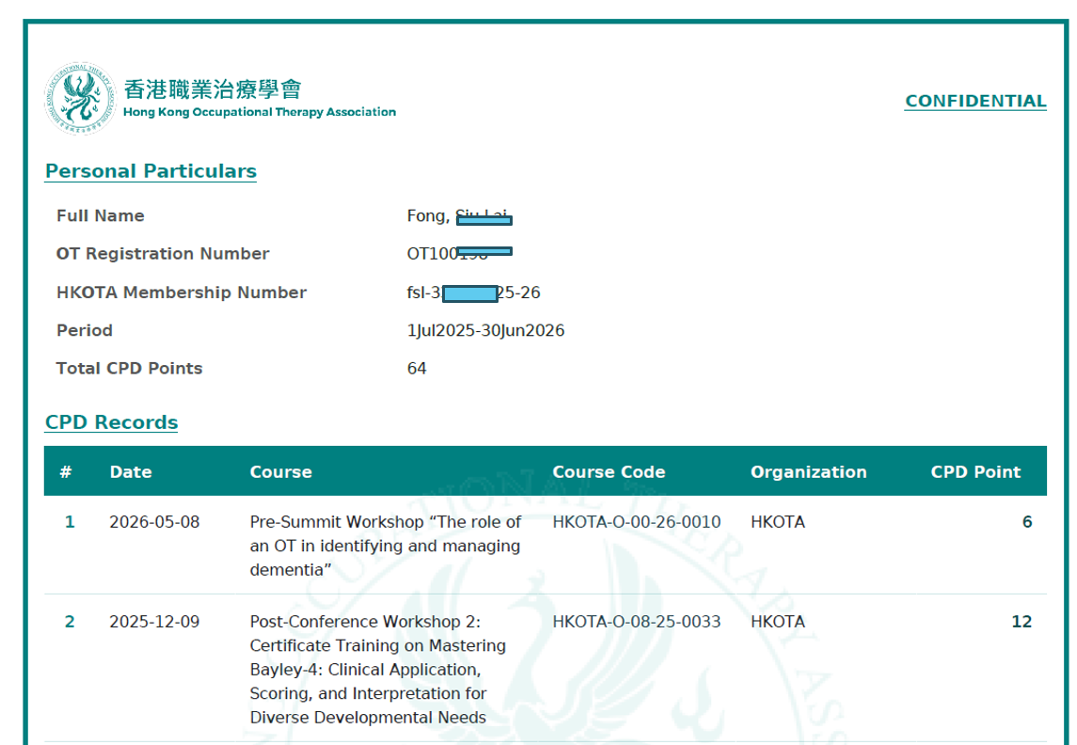
CPD record in HKOTA

Slide 16
Q. What will happen if I cannot fulfill CPD points by the end of practising certificate renewal?
(i) Non-compliance That is Remediable
  An OT must have achieved not less than two-thirds of the required number of points for a cycle.
  (ii) Non-compliance That Is Not Remediable
  An OT who has obtained less than two-thirds of the required number of points for a cycle without acceptable reasons, no practicing certificates will be issued.

Slide 17
Remediable Programme
Various remediable scenarios and the corresponding additional requirement
If a registrant achieves at least two-thirds of the required CPD points for a cycle but fails to attain the full CPD requirement, they are required to obtain the remaining points in the subsequent cycle.
CPD points attained in the 1st Year | CPD points attained in the 2nd Year | CPD points attained in the 3rd Year | Additional CPD points required in the next cycle
10 | 10 | 10 | 15 (remaining pts)
20 | 15 | 0 | 10 (remaining pts)
40 | 0 | 0 | 5 (remaining pts)
The remaining CPD points shall be obtained through participation in Category 2 CPD activities.
The remedial programme shall be completed within the next cycle, as this shall be the final opportunity and no further extension will be granted.
The OT who has failed to make remedy prescribed by the Board for the deficiency without acceptable reasons may then be regarded as a case of noncompliance that is not remediable.
False reporting may constitute a criminal offence and may result in criminal liability.

Slide 18
Thank You

